Slide 1
Calculation Field in Tableau
Tableau Public's data engine allows you to create new mathematical calculations of varying complexity.
A calculated field that you create exists only in your data source in Tableau
Ways to create calculation fields:
  From the Analysis menu, select Create Calculated Field.
  Click on the Context menu of the data source and then select Create Calculated Field.
  Right-click on a field in the Dimensions or Measure pane of a data source. Select Create and then choose Calculated Field.

Slide 2
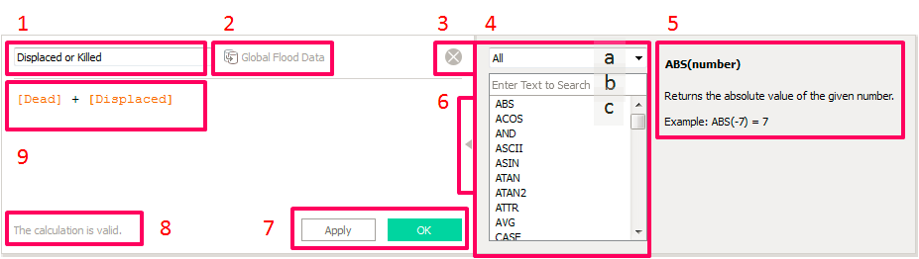
Calculation Field in Tableau

Slide 3
Calculation Field in Tableau
The different types of functions
  Numbers
  Strings
  Date
  Type Conversions
  Logical → IF, CASE and ISNULL
  Aggregate Calculations → sum, avg,count, min
  User Functions
  Table Calculation

Slide 4
Calculation Field in Tableau
Number Functions:
  ABS
  CEILING
  FLOOR
  MAX and MIN
  ROUND
  PI
  LOG, etc

Slide 5
Calculation Field in Tableau
Date Functions: Many date functions in Tableau Public operate on dateparts
  DATEADD → This adds numeric values, in a specific number of dateparts to a date.
  DATEDIFF → This calculates the elapsed number of specified dateparts between two dates.
  DATENAME → This produces the name of the specified datepart of a date.
    DATENAME('month', #7/21/2015#) = "July".
  DATEPARSE → This turns a string into a date in the format that you specify

Slide 6
Calculation Field in Tableau
Date Functions:
  DATEPART → This is similar to DATENAME. It returns the datepart of a specified date but returns a numeric value
    Example: DATEPART('month', #7/21/2015#) = 7
  DAY → This returns the day of the month of a given date
    Example: DAY(#7/21/2015#) = 21
  Etc,….

Slide 7
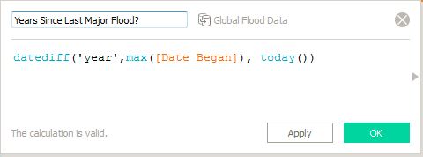
Calculation Field in Tableau
Date Functions:

Slide 8
Calculation Field in Tableau
Type Conversion:
  DATE: string to date
  DATETIME: → string to date and time format
  FLOAT: → integer to float
  INT → whole number rounding off into nearest number
  STR → This turns a sequence of characters, numbers, letters, or special characters into strings.

Slide 9
Calculation Field in Tableau
String Functions:
  CONTAINS: →
  FIND: → This finds the place where a string of characters is located within a field
  LEFT, MID, and RIGHT: → These often work in conjunction with FIND and LEN when extracting fixed or variable strings of characters from a field.
  LEN: → This produces the length of a field.
  MIN and MAX →

Slide 10
Calculation Field in Tableau
String Functions:
  REGEX: →
  REPLACE:: → This replaces a sequence with a specified value.
  TRIM, LTRIM, and RTRIM:: → These trim leading or lagging spaces from a string.
  UPPER and LOWER: → These are commonly used to normalize the contents of a field.

